Slide 1

Illinois
2023 LIFE SCIENCES WORKFORCE TRENDS REPORT:
A RAPIDLY EVOLVING INDUSTRY AND ITS IMPACT ON TALENT DYNAMICS

Slide 2
Life Sciences Industry Job Postings Data for Illinois
This fact sheet represents a state-specific supplement to the national CSBI/TEConomy Life Sciences Workforce Trends report and presents summary information on industry job postings for Illinois. The data represent the latest four years of unique (non-duplicative) job postings across the life sciences industry and its five major subsectors—agricultural feedstock and industrial biosciences; bioscience-related distribution; drugs and pharmaceuticals; medical devices and equipment; research, testing, and medical laboratories. From January 2019 through December 2022, Illinois life sciences companies posted a total of 114,476 unique job opportunities.

Slide 3
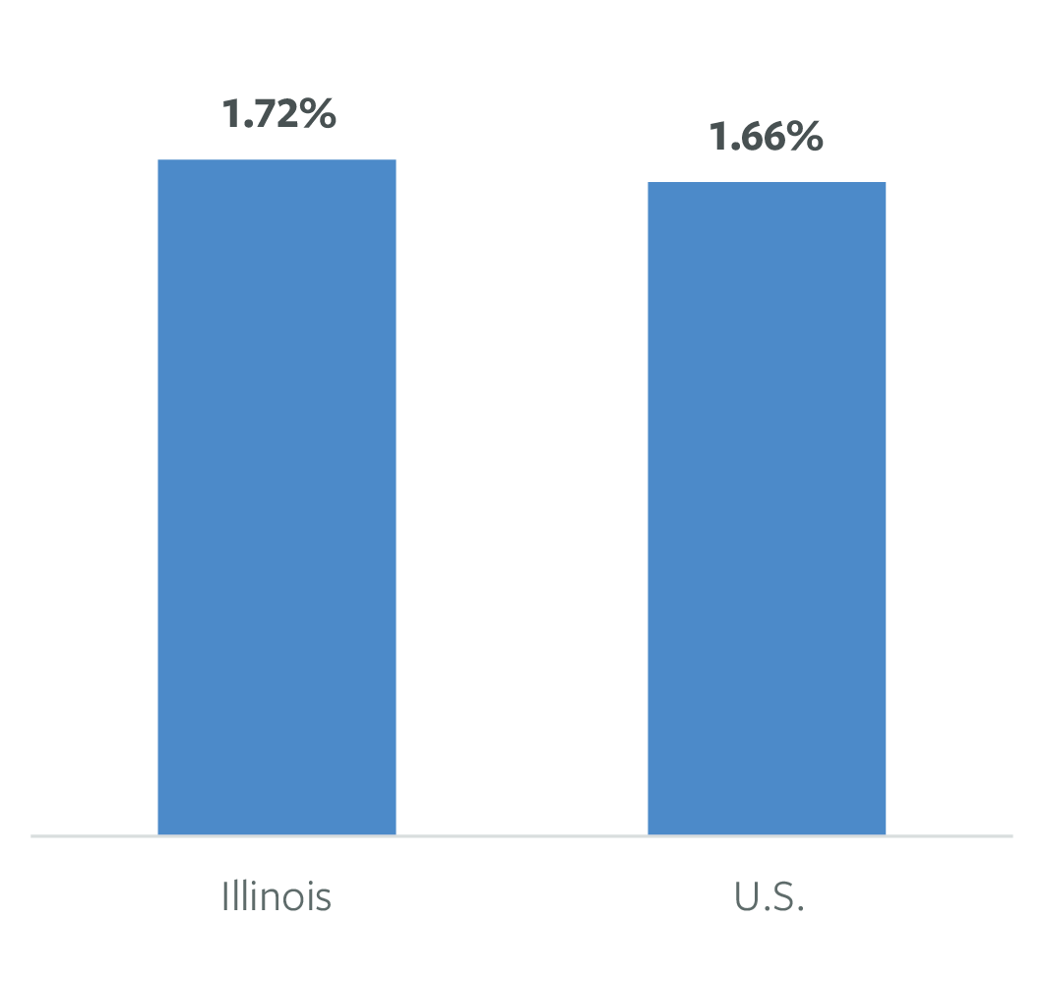
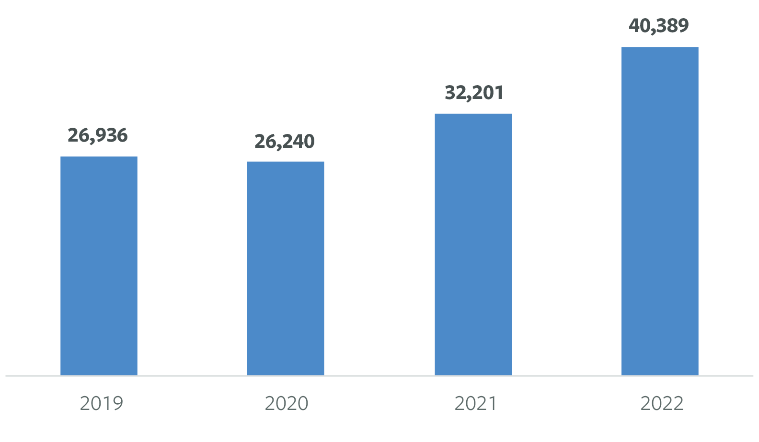
IL Life Sciences Industry: Total Job Postings & Recent Trends, 2019-2022
Trend in Total Unique Job Postings, 2019-2022
Life Sciences' Share of Total Unique Job Postings, 2019-2022
Note: the individual years in trend analysis will not sum to cumulative totals due to unique postings that span across individual years.

Slide 4
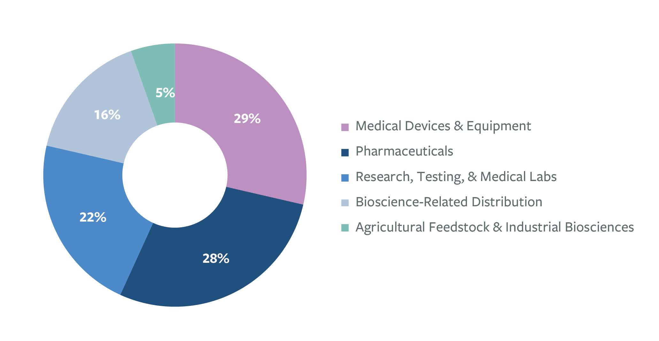
Share of Industry Job Postings in IL by Major Life Sciences Subsector, 2019-2022

Slide 5
Leading IL Companies in Life Sciences Job Postings, 2019-2022
AbbVie
Abbott Laboratories
Medline Industries
Baxter International
Horizon Therapeutics
Bayer
GE Healthcare
Quest Diagnostics
Labcorp Drug Development
IQVIA
Thermo Fisher Scientific
Novartis
Parexel
Stryker
Takeda Pharmaceutical Company

Slide 6
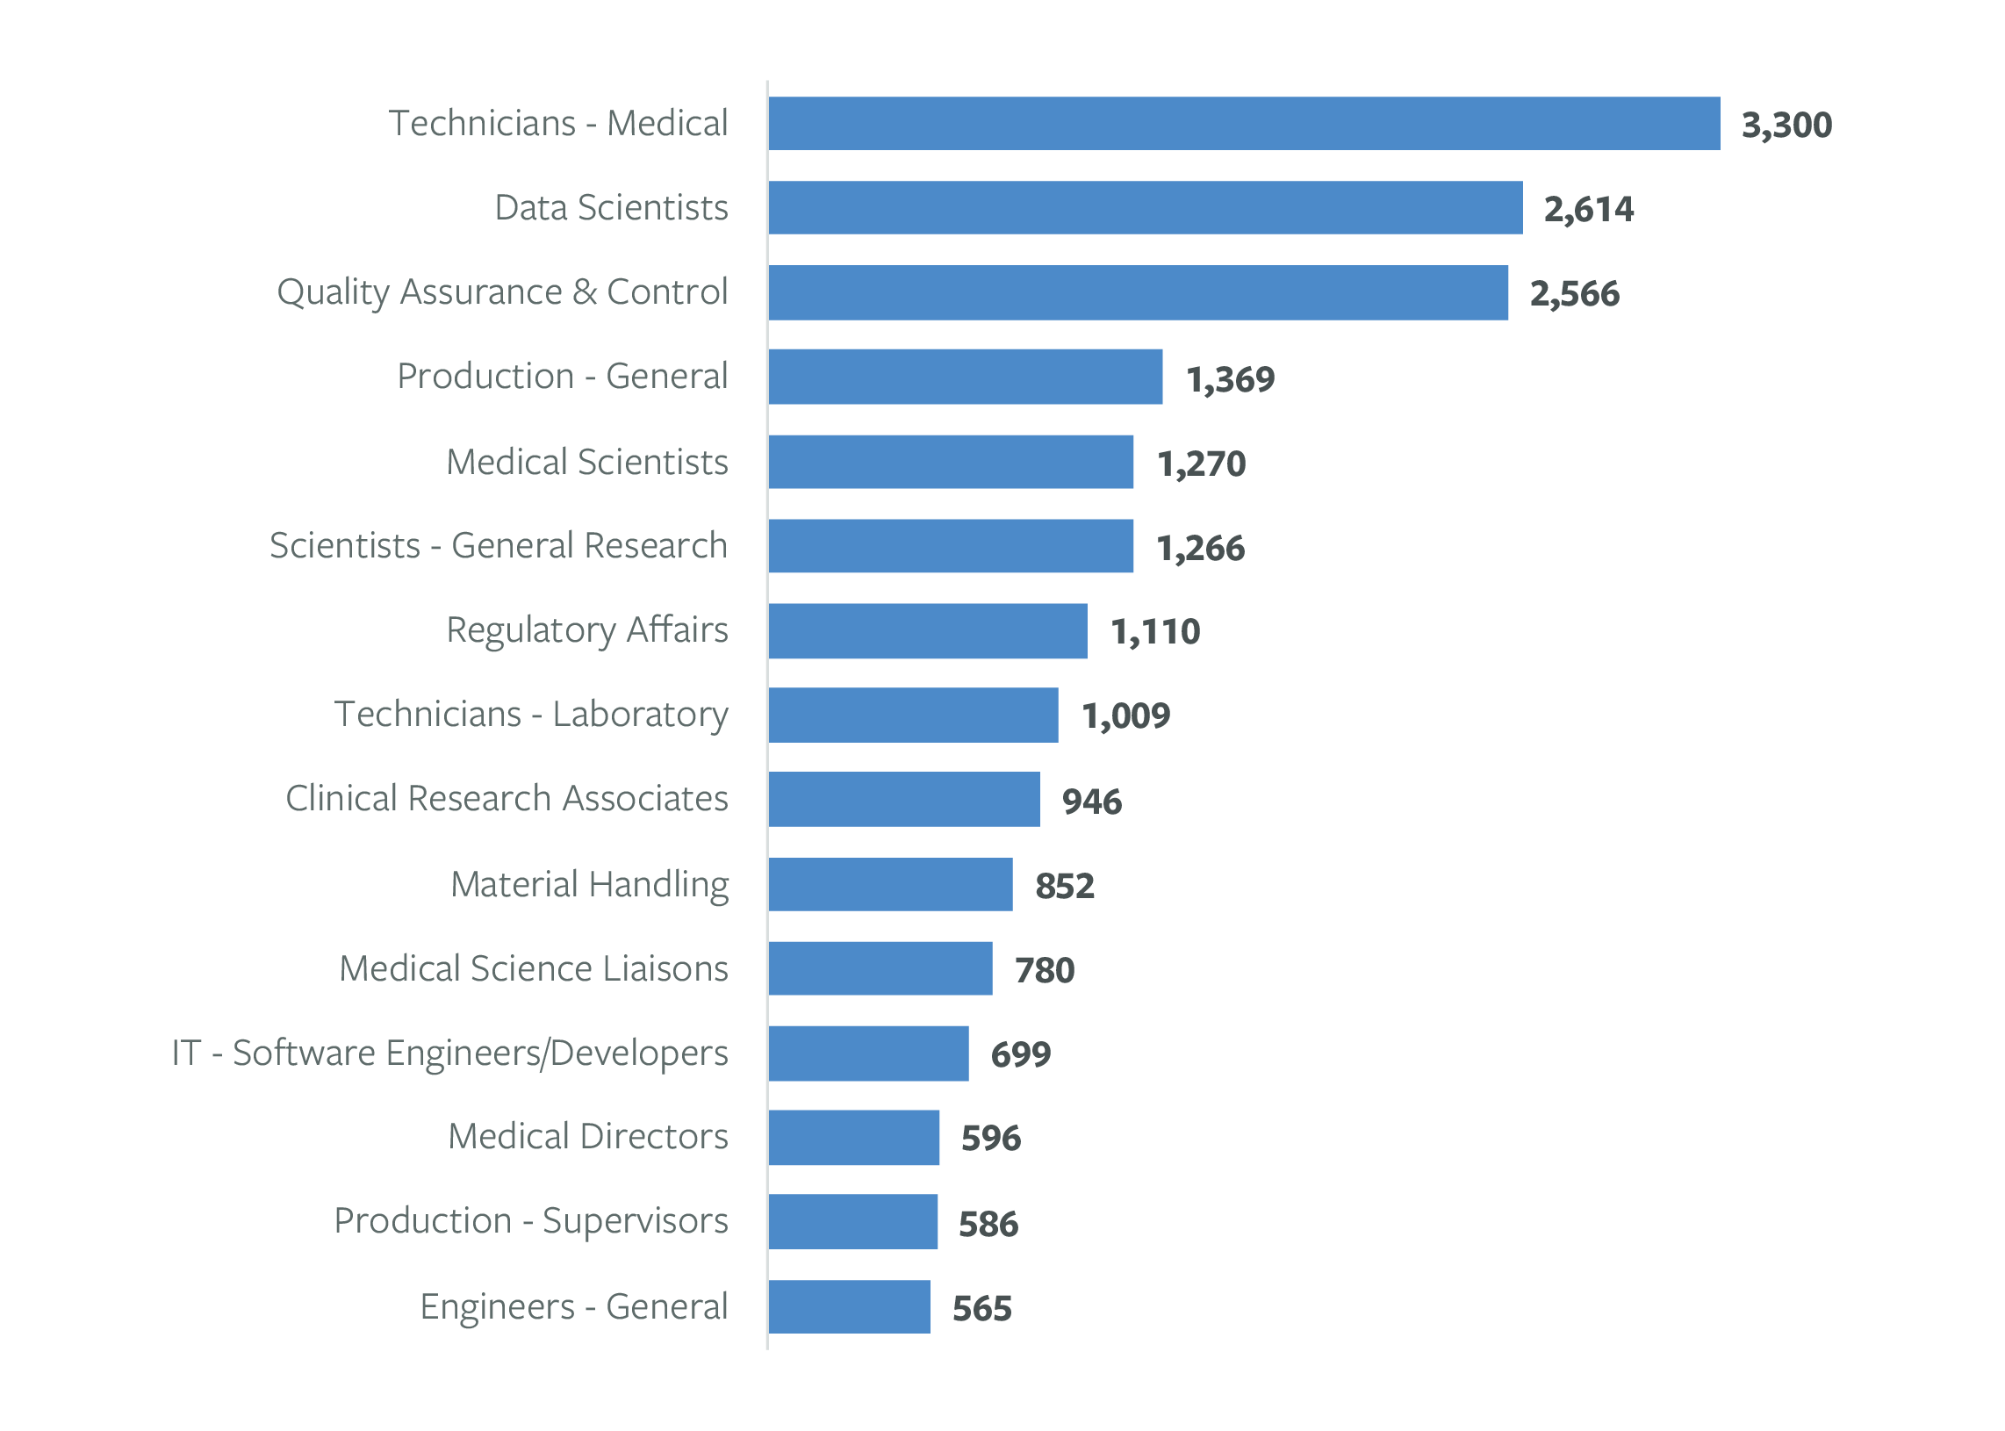
Leading Technical & Production-Related Job Titles/Groupings for IL Life Sciences Hiring Over Last Four Years
Note: Lightcast limits information on job titles and corresponding numbers of postings to the top 1,000, limiting the ability to provide comprehensive totals by categories.
Note: This figure reflects leading job titles in technical and production roles in the life sciences job postings, it excludes large segments of the industry workforce in managerial, sales, and other business functions to focus on more actionable intelligence for life sciences-specific education and workforce development.

Slide 7
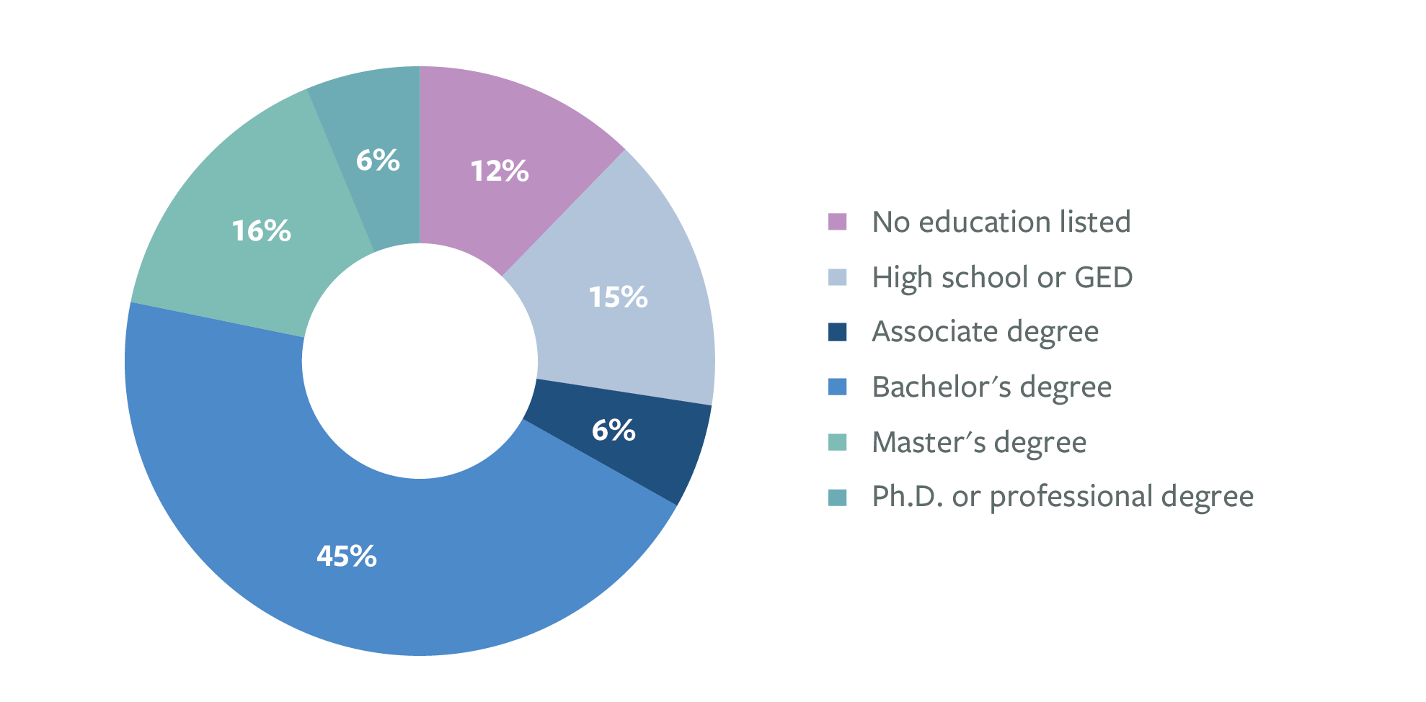
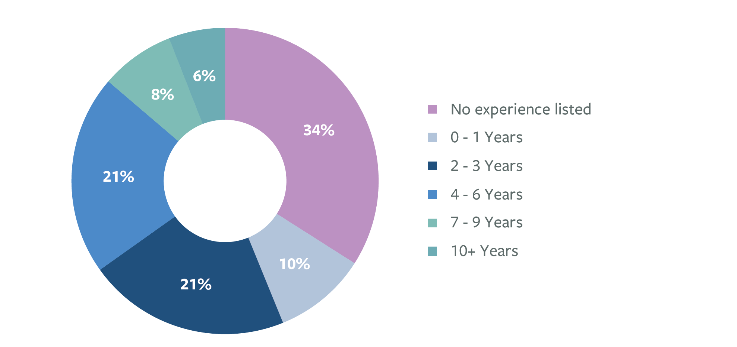
Education & Experience Requirements in IL Life Sciences Industry Job Postings
Degree Requirements
Experience Requirements

Slide 8
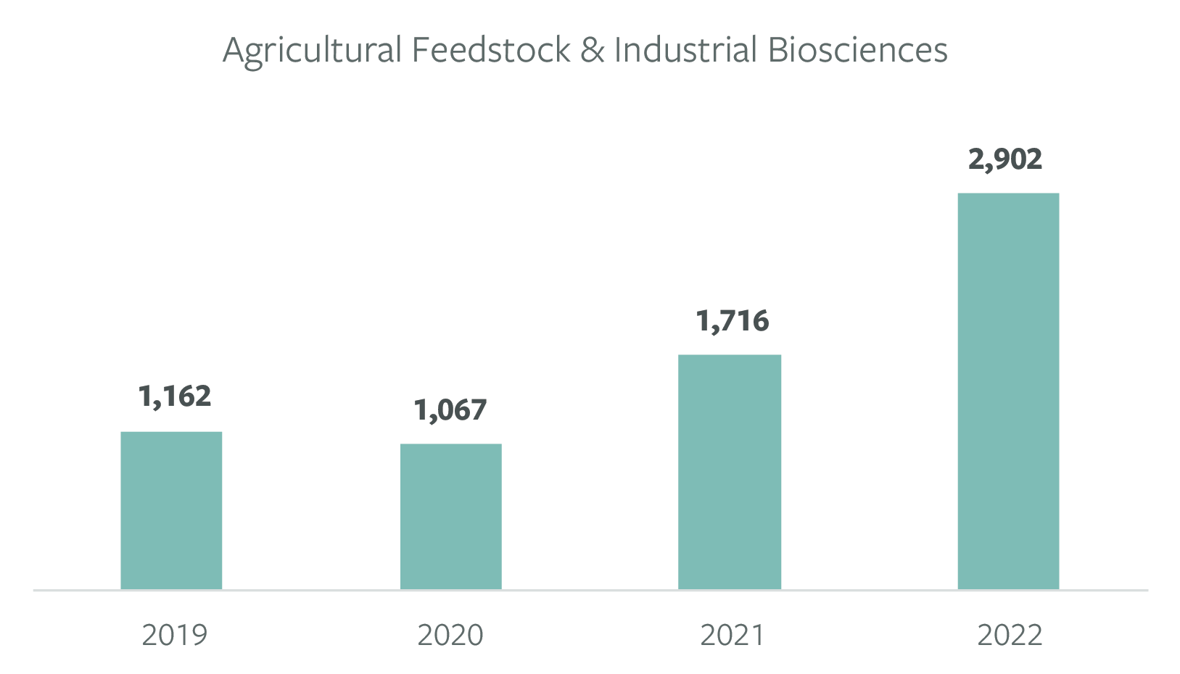
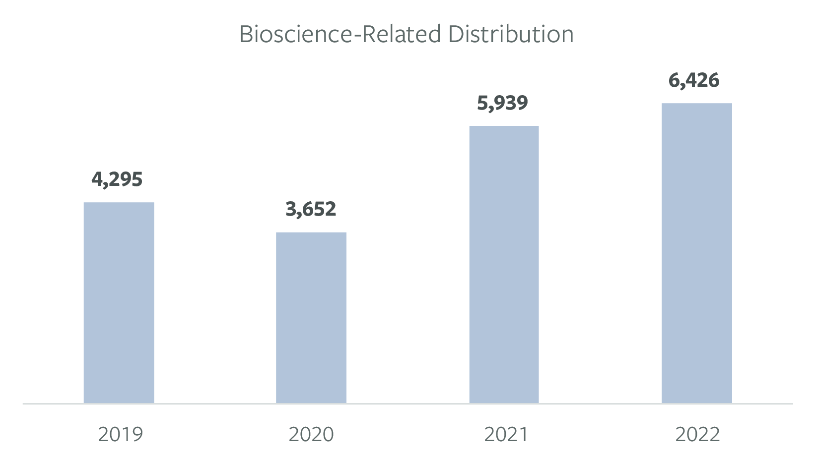
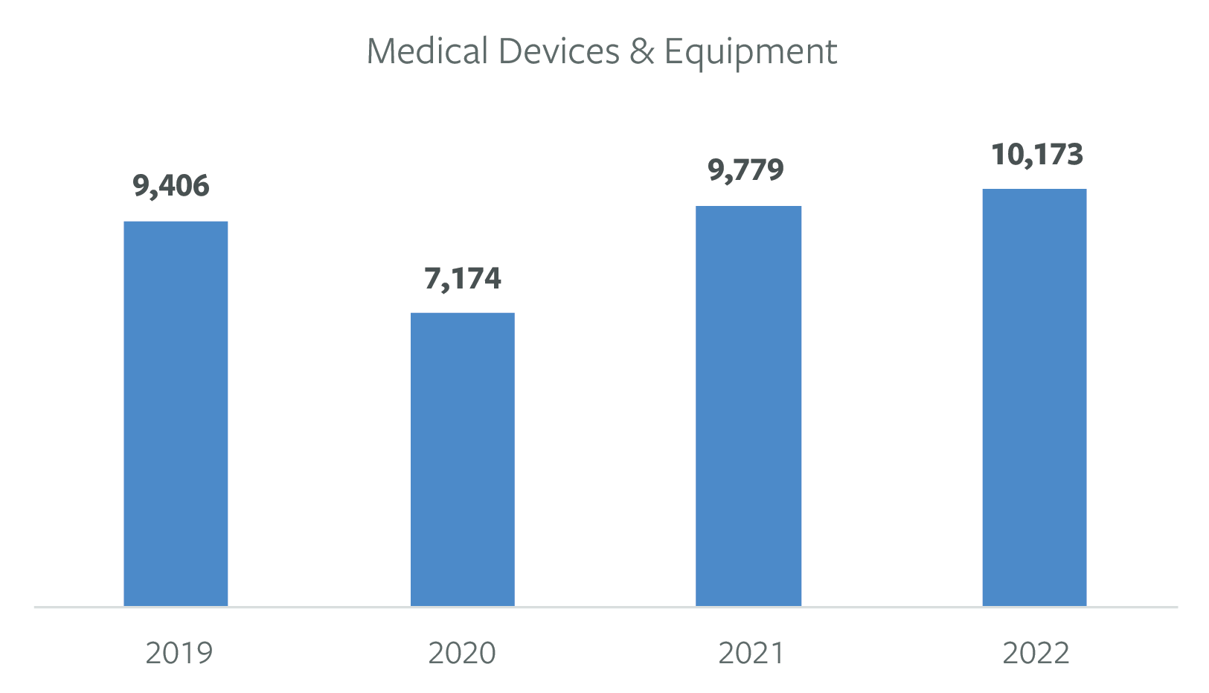
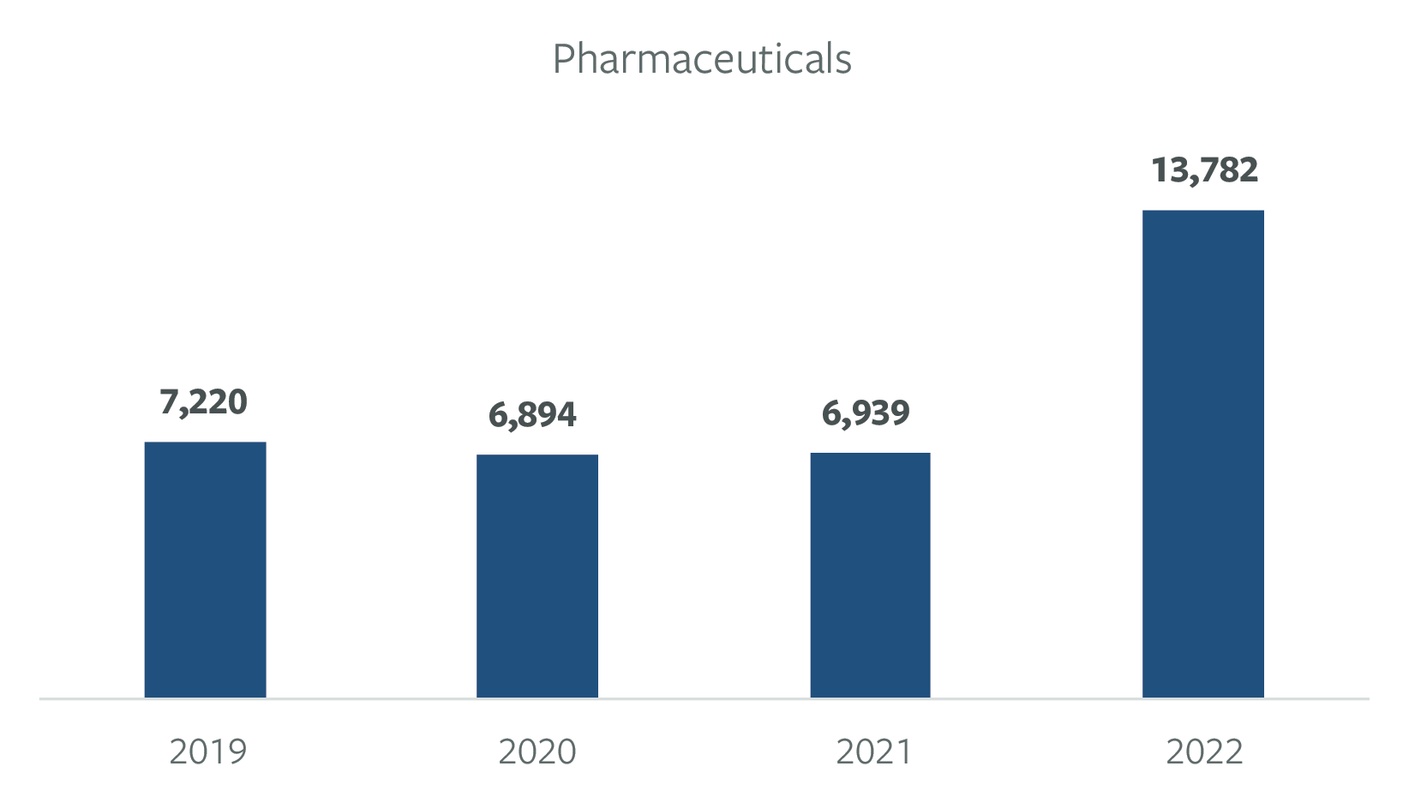
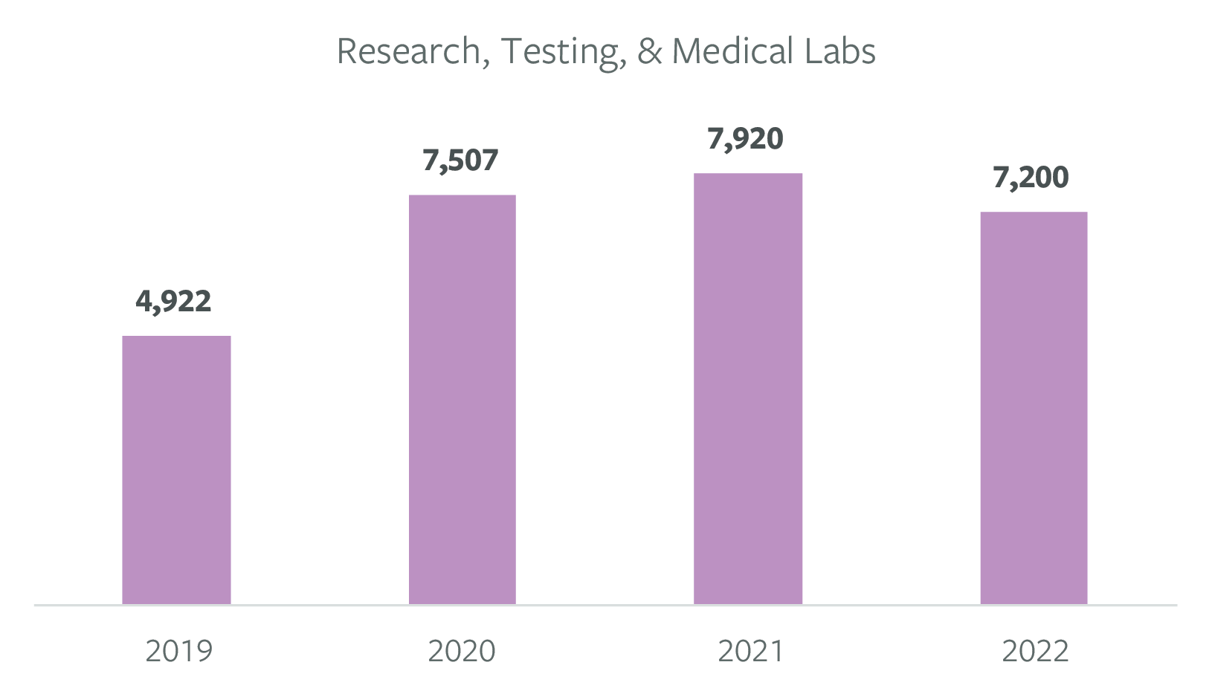
IL Life Sciences Industry Subsectors: Job Posting Trends, 2019-22

Slide 9
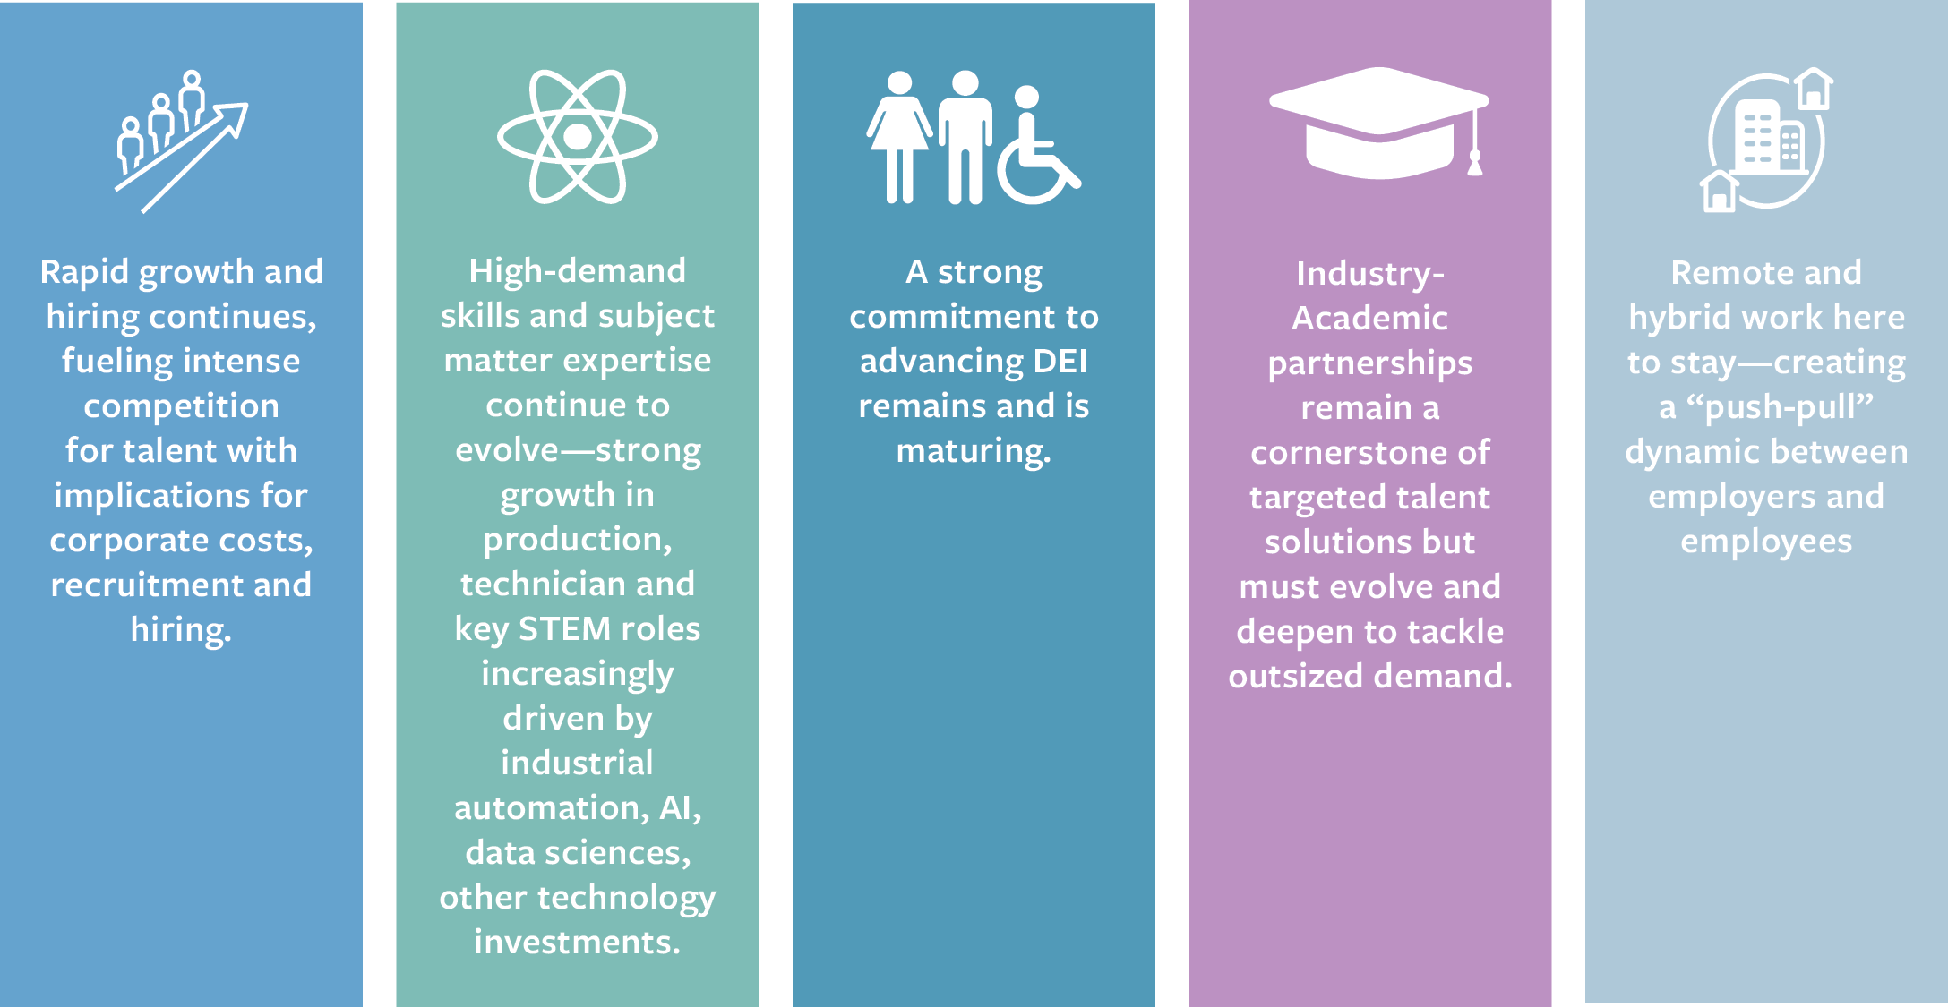
This report is organized across the following trends and themes emerging from the assessment:

Slide 10
To access the complete national report, visit https://www.csbioinstitutes.org
Source Notes: For a detailed definition of the industries included in each of the major life sciences industry subsectors, see the Appendix to the full national report. The data presented in this state fact sheet represent TEConomy Partners’ analysis of the Lightcast Job Posting Analytics database in Q1 of 2023 for the detailed industries included in TEConomy’s NAICS-based definition of the life sciences industry.

